Slide 1
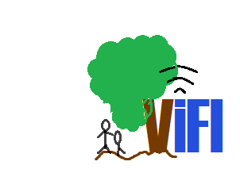
ViFI
Because Internet should be Free!

Slide 2
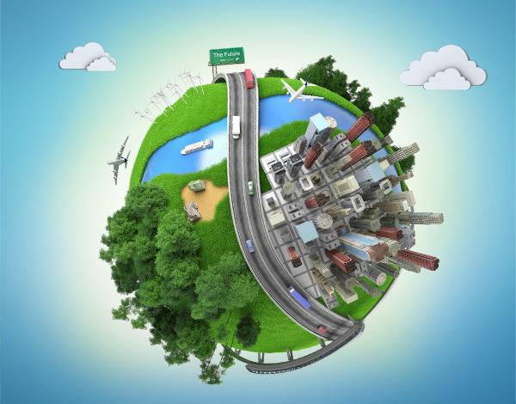
Present scenario….
India’s economy has a dual nature.

Slide 3
Why?
Rural markets are relatively un impacted by globalization
Reason: The set of activities for these markets and capabilities are different from national or global economies

Slide 4
Change?
One out of every 10 people on the earth lives in rural India
Need fifty years of double digit growth in per capita income
The national economic growth sustains only when there is rural economic growth

Slide 5
How?
in situ urbanization.
Make most rural Indians an investment

Slide 6
SERVICES
Market making and access to markets
Demand aggregation of agricultural and non-agricultural inputs
Education and library
Health care
Banking and financial intermediation
Telecommunications and internet access
Charity and social services
Market information
Weather and agricultural information

Slide 7
A common feature of these services is that they are all dependant to a large extent on information and communications technologies

Slide 8
The Idea
.Computer science problem
.minimizing cost
.rural isp (at village level )
-> functionality
-> how is this going to decrease the cost to zero?

Slide 9
Why mobile platform ..
Next billion users are going to access net on phones first time.
218.9 million active SIM users in rural India.
Has become a part in life of all.

Slide 10
Competition..
Eg.NetZero in UK – brand adds or time limit.
Consumer reluctance

Slide 11
Making money..
We earn when villagers earn.
Government incentives

Slide 12
Positioning
M-Commerce
450 million mobile users in India by 2015.

Slide 13
What makes us different?
DSI: First and Free
New technology
Thinking BIG is what makes us different.

Slide 14
Acknowledgments
Dr. Baba Prasad.

